Slide 1

Vel Tech Rangarajan Dr. Sagunthala R&D Institute of Science and Technology
School of Computing
Department of Computer Science and Engineering
10211CS224 / FULL STACK APPLICATION DEVELOPMENT (JAVA)
PROJECT REVIEW : MILESTONE PROJECT – 2
Date: 26-04-2026
Smart Campus Event Management System
SDG: SDG 11 – Sustainable Cities & Communities
Presented By:
M.V.Aaruhya Reddy – VTU25078 – 23UECS1124
Courses Handling Faculty:
Dr.ANGELINE LYDIA

Slide 2
INTRODUCTION
Campus event management is a critical function for educational institutions of all sizes.
Manual event coordination leads to communication gaps, missed registrations, and poor attendance tracking.
Smart Campus Event Management System is a web-based application built using Java Full Stack technologies (Spring Boot).
The system provides a student-facing event portal and an admin panel for creating and managing campus events.
It supports event registration with student details, admin login, event listing by type, and capacity tracking.
Aligned with SDG 11 – Sustainable Cities & Communities, the project promotes digital transformation in campus administration.
1
2
3
4
5
6
7
8
9

Slide 3
PROBLEM STATEMENT
Most colleges still manage events using paper forms, WhatsApp groups, or spreadsheets – leading to errors and missed registrations.
Students have no centralized platform to discover and register for upcoming workshops, seminars, or cultural events in real time.
Without an automated system, event organizers cannot track attendance counts or enforce seat capacity limits effectively.
There is no dedicated admin interface to create, edit, or delete events with secure authentication and role separation.
A need exists for a reliable, web-based, full-stack event management solution that automates campus event coordination with a user-friendly portal.
1
2
3
4
5
6
7
8
9

Slide 4
OBJECTIVE(S)
To design and develop a web-based Smart Campus Event Management System using Java Full Stack (Spring Boot) that enables real-time event discovery and registration.
To implement an admin panel with secure login for creating, editing, and deleting campus events with department-wise categorization and capacity control.
To improve student engagement by replacing manual coordination with an automated, category-based event listing system with persistent database storage.
To evaluate the system's performance in terms of usability, registration accuracy, and capacity tracking across multiple event types and departments.
1
2
3
4
5
6
7
8
9

Slide 5
PROPOSED SYSTEM
Smart Campus Event Management System is a full-stack web application providing a centralized portal for students to discover and register for campus events.
Events are organized by type (Workshop, Seminar, Cultural, Sports) and department (CSE, IT, ALL) with date, venue, and capacity details.
Admin panel with secure authentication allows creating, editing, and deleting events with full CRUD operations via Spring Boot REST API.
Student registration form collects Full Name, Email, and Roll Number, with instant success confirmation and capacity enforcement.
The system uses Spring Boot with JPA and MySQL/H2 database for persistent event and registration data with full relational storage.
Eliminates manual coordination errors, provides instant registration confirmation, and reduces overhead for campus event organizers.
1
2
3
4
5
6
7
8
9

Slide 6
PROPOSED SYSTEM ARCHITECTURE
System Architecture – Smart Campus Event Management System
Explain:
Input: Event details (title, description, date, dept, venue, type, capacity) and Student registration (Name, Email, Roll No).
Processing: Spring Boot REST API handles event CRUD, registration validation, capacity enforcement, and admin authentication.
Database: MySQL / H2 Database via Spring Data JPA stores events and registrations persistently with entity relationships.
Output: Student event portal, event detail with registration form, admin dashboard for event management, success/error alerts.
1
2
3
4
5
6
7
8
9

Slide 7
WORKFLOW
Workflow – Smart Campus Event Management System
Step 1 – Student visits Events Portal: All upcoming campus events are listed with name, date, department, venue, and type badge.
Step 2 – Browse & Select Event: Student clicks on an event to view full details including capacity, description, and registration form.
Step 3 – Register for Event: Student fills in Full Name, Email, and Roll Number on the event detail page and clicks Register Now.
Step 4 – Confirmation Shown: System validates input, checks capacity, saves registration, and shows success confirmation message.
Step 5 – Admin Manages Events: Admin logs in (admin/admin123), creates/edits/deletes events through secure admin dashboard.
1
2
3
4
5
6
7
8
9

Slide 8
TECHNOLOGIES USED
Frontend: HTML5, CSS3, JavaScript – Responsive UI with event cards, registration forms, type badges, and navigation.
Backend: Java + Spring Boot – REST APIs for event management and student registration with Spring MVC and Spring Data JPA.
Database: MySQL / H2 Database – Persistent storage for events and registrations via Spring Data JPA entity relationships.
Tools: IntelliJ IDEA / VS Code (Editor), Postman (API Testing), Git (Version Control), GitHub (Repository Hosting).
Requirements: Java 17+, Maven, MySQL, Any modern browser (Chrome/Edge/Firefox), OS: Windows/Linux/macOS, RAM: 4GB+.
1
2
3
4
5
6
7
8
9

Slide 9
MODULE DESCRIPTION
Smart Campus Event Management System – Module Description
Module 1: Event Listing Module
Displays all upcoming campus events with event name, type badge (Workshop/Seminar/Cultural), date, department, venue, and description for student browsing.
Module 2: Event Detail & Registration Module
Shows complete event details including capacity. Provides a registration form collecting Full Name, Email, and Roll Number with success confirmation on submit.
Module 3: Admin Authentication Module
Secure admin login with username/password (default: admin/admin123). Grants access to admin dashboard for full event management operations.
Module 4: Event Management (CRUD) Module
Admin can create new events with all details, edit existing events, and delete completed or cancelled events through a secure admin-only interface.
1
2
3
4
5
6
7
8
9

Slide 10
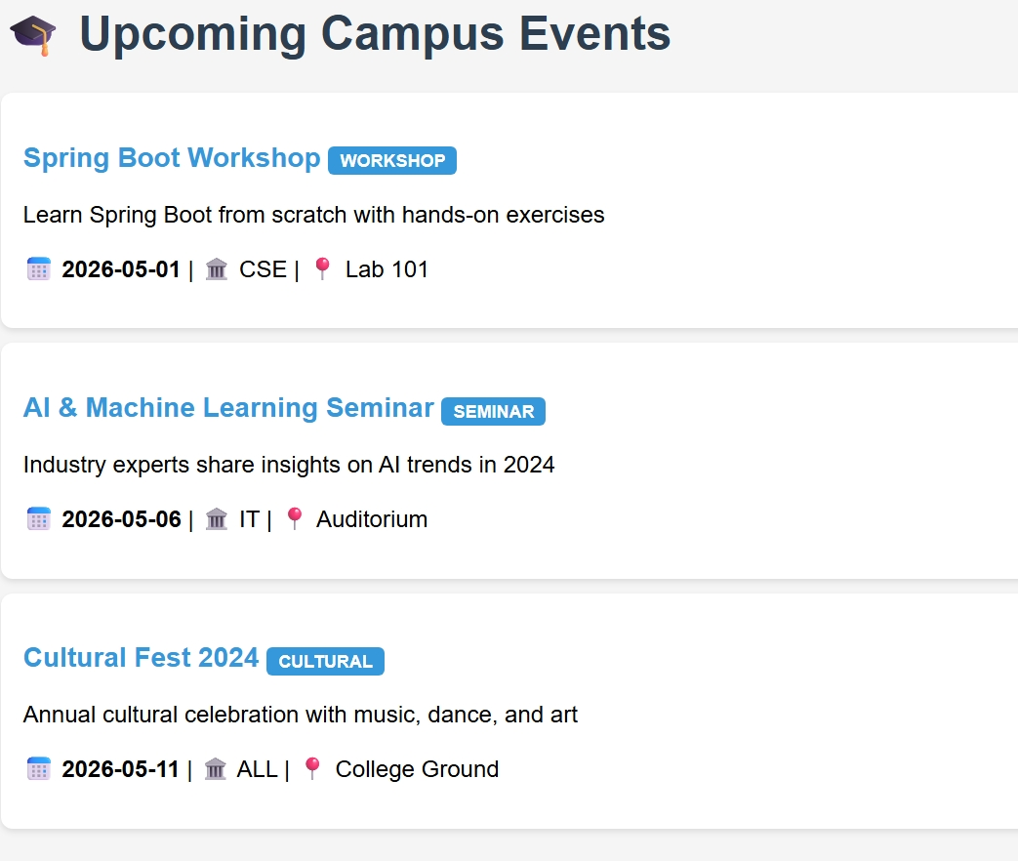
IMPLEMENTATION SCREENSHOTS
Screenshot 1: Upcoming Campus Events – Student Event Listing Page
The Events Portal displays all upcoming campus events with type badges (Workshop, Seminar, Cultural), dates, departments, and venues.
1
2
3
4
5
6
7
8
9

Slide 11
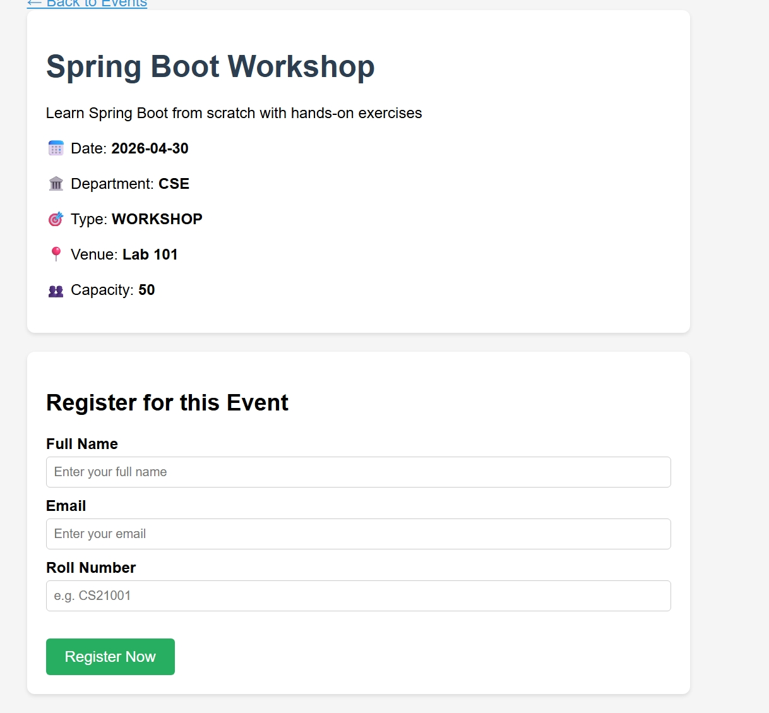
IMPLEMENTATION SCREENSHOTS
Screenshot 2: Event Detail Page – Spring Boot Workshop Registration Form
Event detail page shows all event info (date, dept, type, venue, capacity) with a student registration form for Full Name, Email, and Roll Number.
1
2
3
4
5
6
7
8(A)
9

Slide 12
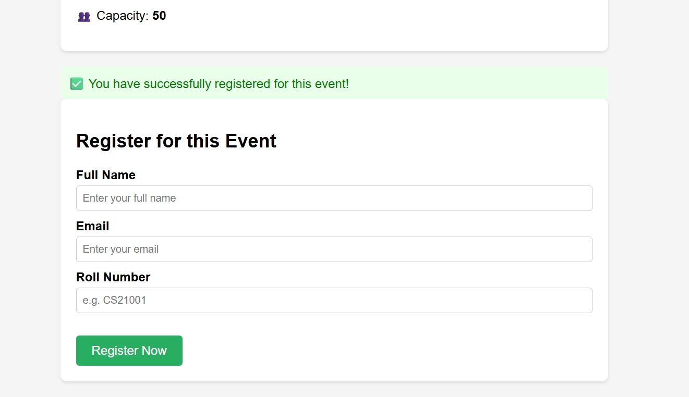
IMPLEMENTATION SCREENSHOTS
Screenshot 3: Registration Success – Confirmation Message Displayed
After successful registration, the system displays a green confirmation banner: "You have successfully registered for this event!"
1
2
3
4
5
6
7
8(B)
9

Slide 13
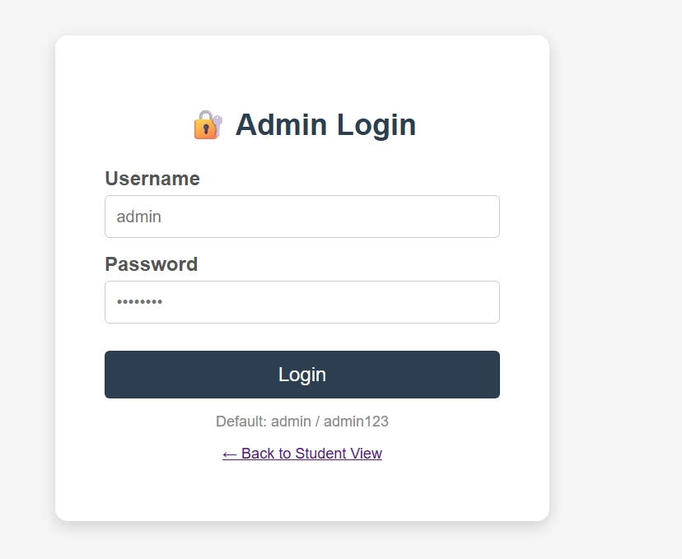
IMPLEMENTATION SCREENSHOTS
Screenshot 4: Admin Login Panel – Secure Admin Authentication Page
Admin login panel provides secure authentication (admin/admin123). Grants access to the event management dashboard for full CRUD operations.
1
2
3
4
5
6
7
8(C)
9

Slide 14
ADVANTAGES & LIMITATIONS
ADVANTAGES
Centralized event portal – students discover and register for all campus events from one place with no manual coordination.
Secure admin panel with authentication – only authorized admins can create, edit, or delete events from the system.
Real-time registration confirmation with capacity enforcement prevents overbooking at any campus event.
Multi-type event support (Workshop, Seminar, Cultural, Sports) with department-wise categorization for all students.
Lightweight, responsive UI – works on any modern browser with clean card-based event listing and intuitive navigation.
LIMITATIONS
No email notification system – registered students do not receive confirmation emails or event reminders automatically.
No multi-user role system – all admins share the same credentials without individual admin accounts or permissions.
No analytics or reporting module (event-wise attendance charts, export to PDF/Excel) available in current version.
No search or filter feature on the student portal – students must scroll through all events to find relevant ones.
1
2
3
4
5
6
7
8
9

Slide 15
Thank you

